Slide 1
Chapter 7 – Part 2
NETWORK OPTIMIZATION
(NETWORK SIMPLIFICATION)

Slide 2
NETWORK OPTIMIZATION
Optimize network structure to obtain a simpler network
The constraint that no exchanger should have a temperature difference smaller than ΔTmin can now be relaxed.
Network optimization is based on the redistribution of the exchanger duties. Possible result: some exchangers are made larger, some smaller and some are removed from the design. Exchangers are removed if their duty is zero

Slide 3
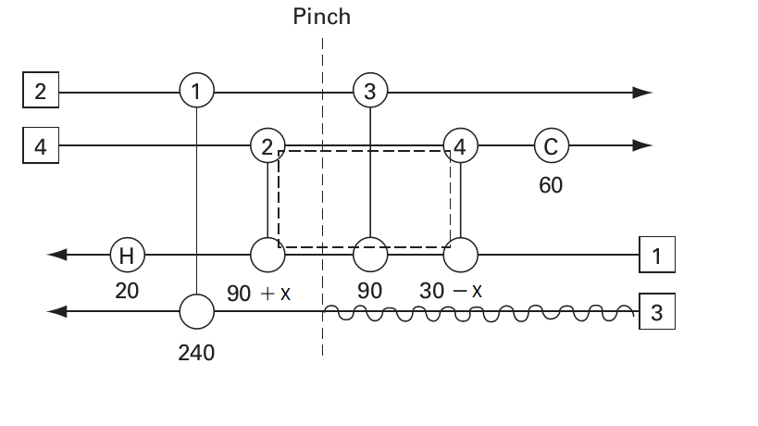
Heat Loop
A heat loop is a loop in the HEN around which duties can be shifted from one exchanger to another without affecting stream duties

Slide 4
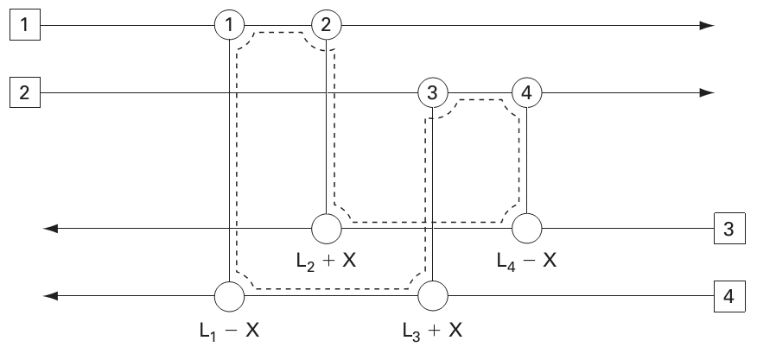
Heat Loop

Slide 5
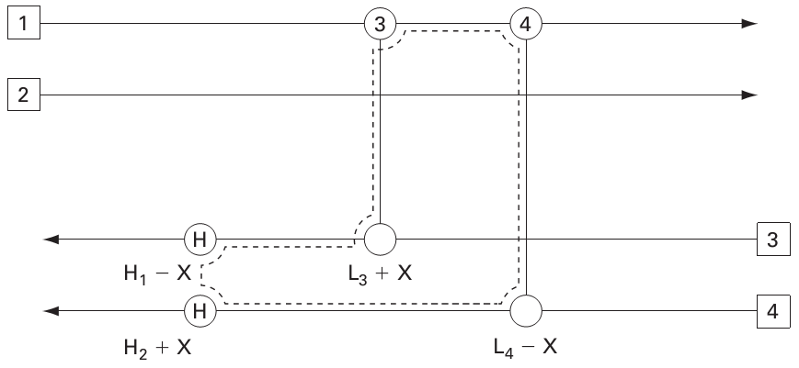
Heat Loop
Heater/cooler can be included in a loop

Slide 6
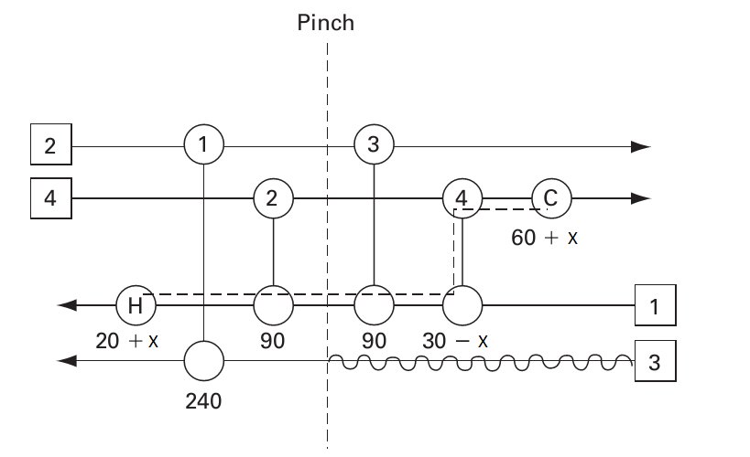
Heat Path
Heat paths: paths that connect two different utilities, also called utility paths

Slide 7
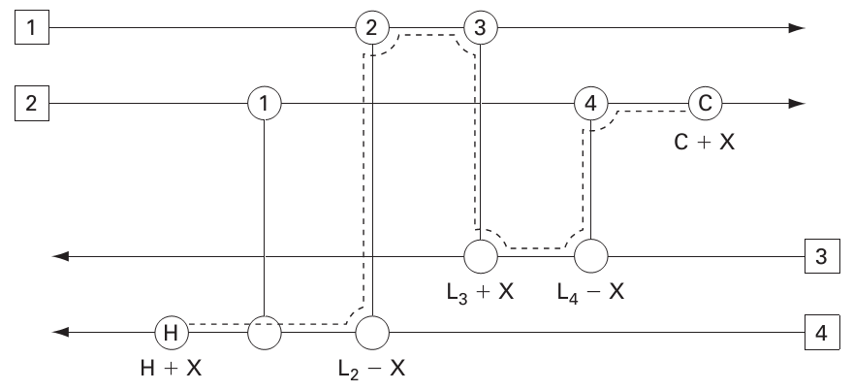
Heat Path

Slide 8
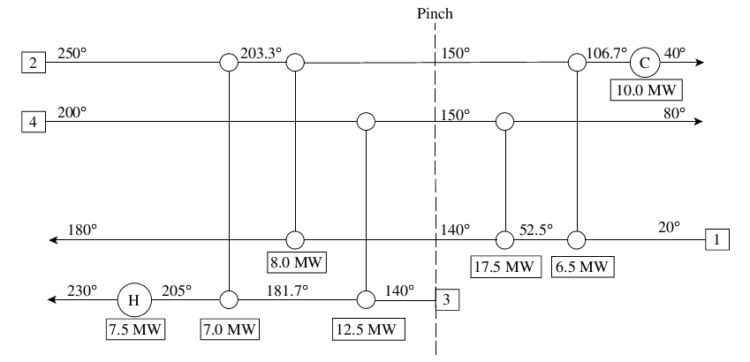
NETWORK OPTIMIZATION – Example 1
An MER network by pinch design method

Slide 9
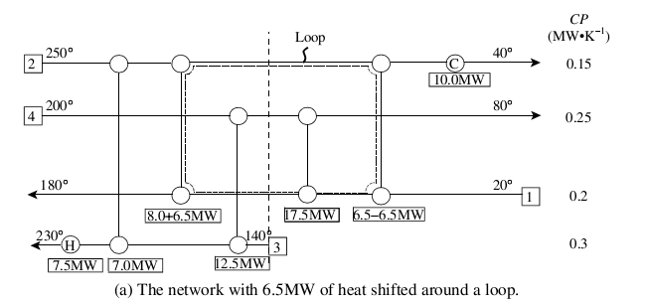
NETWORK OPTIMIZATION – Example 1

Slide 10
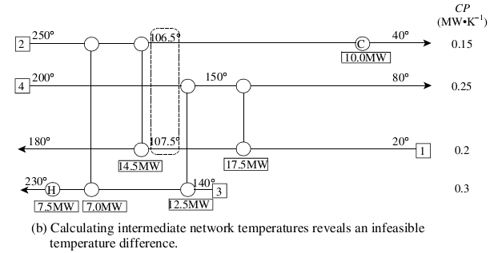
NETWORK OPTIMIZATION – Example 1

Slide 11
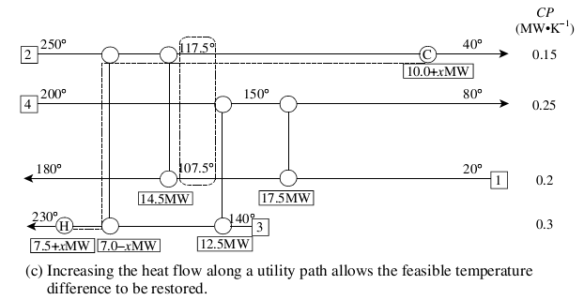

NETWORK OPTIMIZATION – Example 1

Slide 12
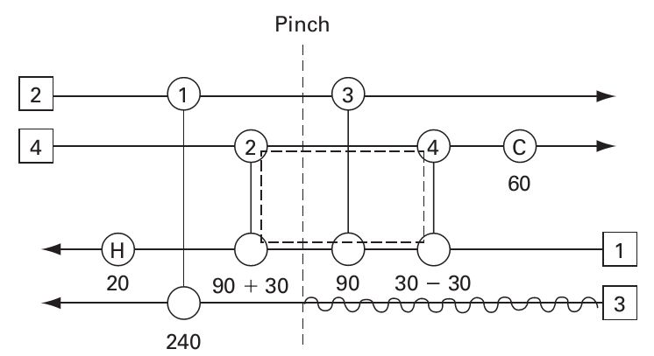
NETWORK OPTIMIZATION – Example 2

Slide 13
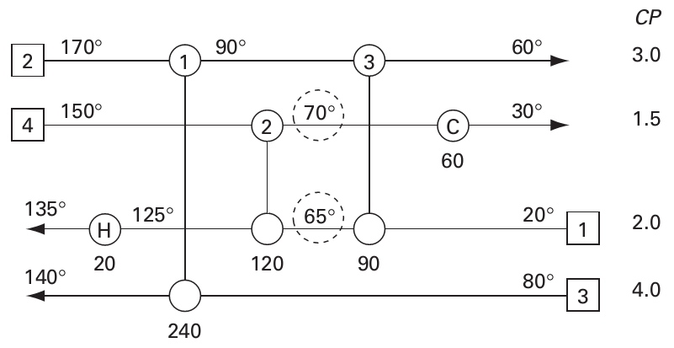
NETWORK OPTIMIZATION – Example 2

Slide 14
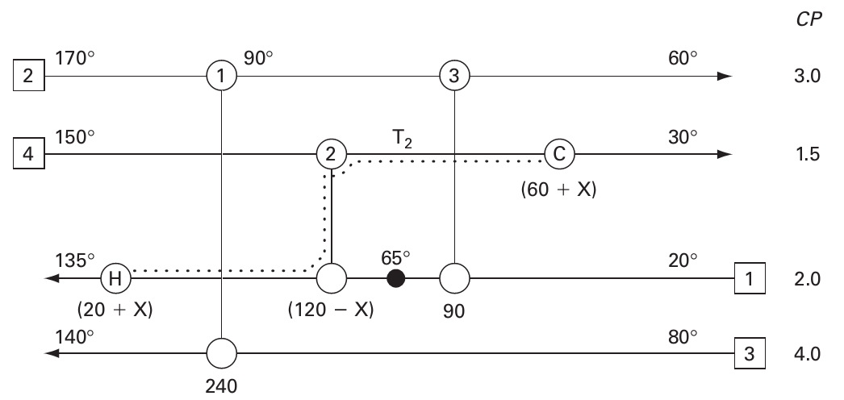
NETWORK OPTIMIZATION – Example 2

Slide 15
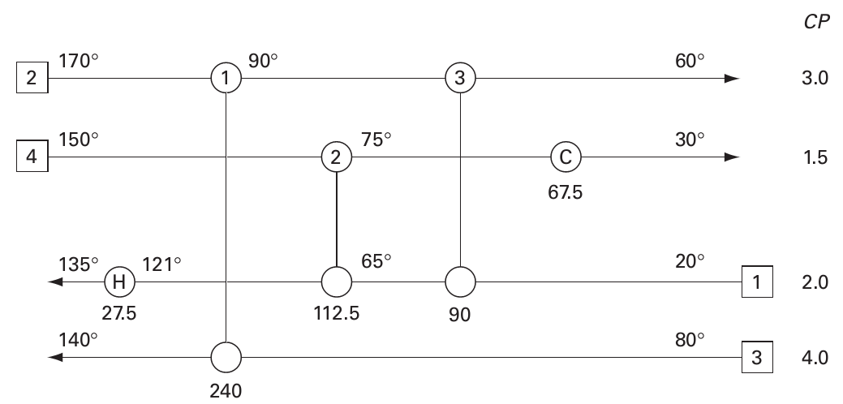
NETWORK OPTIMIZATION – Example 2

Slide 16
Grassroot (new) network design by PA – A complete example
Stream data
Stream Name | Supply Temperature | Target Temperature | FCp
 | °C | °C | kW/°C
H1 | 180 | 40 | 40
H2 | 150 | 60 | 30
C1 | 30 | 180 | 60
C2 | 80 | 160 | 20

Slide 17
Grassroot (new) network design by PA – A complete example
Heat cascade at ΔT_{min} = 20 ºC
Shift Temperature | Interval | T_{(i+1)}-T_{i} | dH | Feasible Cascade
°C |  | °C | kW
190 |  |  |  | ▼ | 2900
 | 1 | 20 | -1200.0 | -1200
170 |  |  |  | ▼ | 1700
 | 2 | 30 | -1200.0 | -1200
140 |  |  |  | ▼ | 500
 | 3 | 50 | -500.0 | -500
90 |  |  |  | ▼ | 0
 | 4 | 40 | 400.0 | 400
50 |  |  |  | ▼ | 400
 | 5 | 10 | -200.0 | -200
40 |  |  |  | ▼ | 200
 | 6 | 10 | 400.0 | 400
30 |  |  |  | ▼ | 600

Slide 18
Grassroot (new) network design by PA – A complete example
Hot pinch = 100 ºC, cold pinch = 80 ºC
Q_{H,min} = 2900 kW, Q_{C,min} = 600 kW

Slide 19
The complete example – MER design
1
1600
100 ºC
100 ºC
CP
20
1600
1800
600
H1
180 ºC
2
100 ºC
4
40 ºC
40
20
C
H2
1500
1200
150 ºC
3
5
60 ºC
30
180 ºC
2900
130 ºC
30
C1
36
30 ºC
60
H
133.33 ºC
30
24
C2
160 ºC
20
80 ºC

Slide 20
The complete example – Loop in MER design
1
1600
100 ºC
100 ºC
CP
20
1600
1800
600
H1
180 ºC
2
100 ºC
4
40 ºC
40
20
C
H2
1500 + 1200
1200 - 1200
150 ºC
3
5
60 ºC
30
180 ºC
2900
130 ºC
30
C1
36
30 ºC
60
H
133.33 ºC
30
24
C2
160 ºC
20
80 ºC

Slide 21
The complete example – Simplified MER with E5 eliminated
1600
1
20
CP
1600
1800
600
H1
180 ºC
2
100 ºC
4
40 ºC
40
20
C
H2
150 ºC
2700
3
60 ºC
30
180 ºC
2900
131.67 ºC
105 ºC
60 ºC
C1
30 ºC
60
H
C2
160 ºC
80 ºC
20

Slide 22
The complete example – Path in simplified MER
1600
1
20
CP
1600
1800 - X
600 + X
H1
180 ºC
2
100 ºC
4
40 ºC
40
20
C
H2
150 ºC
2700
3
60 ºC
30
2900 + X
180 ºC
131.67 ºC
105 ºC
60 ºC
30 ºC
C1
60
H
C2
160 ºC
80 ºC
20
1800 - X = 60*(40-30) => X = 1200

Slide 23
The complete example – Restore ΔT_{min} = 20 ºC in simplified MER
1600
100 ºC
1
20
CP
1600 - Y
600
1800 + Y
H1
180 ºC
2
100 ºC
4
87.5 ºC
40 ºC
20
40
100 ºC
C
H2
150 ºC
2700
3
60 ºC
30
4100 + Y
180 ºC
85 ºC
40 ºC
30 ºC
C1
60
H
C2
160 ºC
80 ºC
20
1600 - Y = 20*(180-105) => Y = 100

Slide 24
The complete example – Restore ΔT_{min} = 20 ºC in simplified MER
1600
100 ºC
1
20
CP
1500
600
1900
H1
180 ºC
2
102.5 ºC
4
87.5 ºC
40 ºC
20
40
105 ºC
C
H2
150 ºC
2700
3
60 ºC
30
180 ºC
4200
110 ºC
85 ºC
40 ºC
C1
30 ºC
60
H
C2
160 ºC
80 ºC
20

Slide 25
The complete example – Simplified MER vs. MER design
 | MER | Simplified MER
Number of process heat exchangers | 5 | 4 (E5 eliminated)
E2 duty (kW) | 1600 | 1500
E3 duty (kW) | 1500 | 2700
E4 duty (kW) | 1800 | 600
Q_{H,min} (kW) | 2900 | 4200
Q_{C,min} (kW) | 600 | 1900

Slide 26
The complete example – Path in simplified MER
1600
1
20
CP
1600
1800
600
H1
180 ºC
2
100 ºC
4
40 ºC
20
40
C
H2
150 ºC
2100
600
3
60 ºC
30
80 ºC
C
2900 + 600
180 ºC
131.67 ºC
95 ºC
60 ºC
30 ºC
C1
60
H
C2
160 ºC
80 ºC
20

Slide 27
The complete example – Path in simplified MER
1600
100 ºC
1
20
CP
1300
107.5 ºC
1800
900
H1
180 ºC
2
4
62.5 ºC
40 ºC
20
40
115 ºC
C
H2
150 ºC
2100
600
3
80 ºC
60 ºC
30
C
180 ºC
3800
116.67 ºC
95 ºC
60 ºC
C1
30 ºC
60
H
C2
160 ºC
80 ºC
20

